Slide 1
ENGINEERING DRAWING
Topic:
Line Types

Slide 2
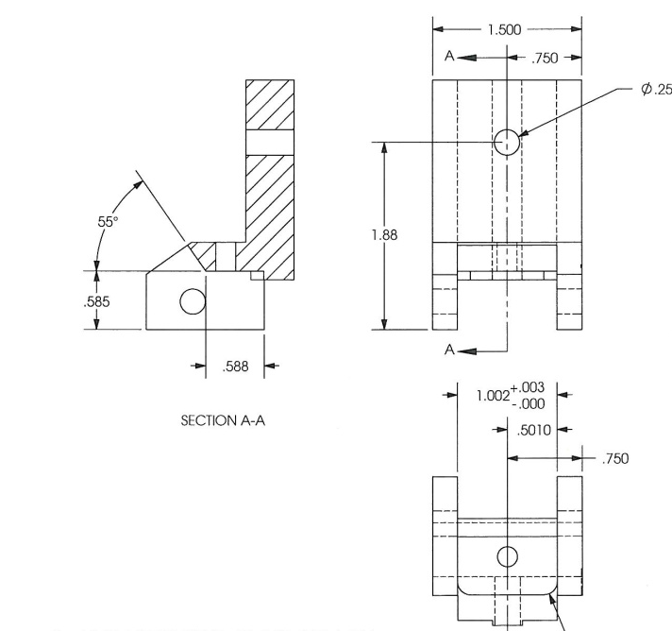
Introduction to Lines
LINES
Lines are like the alphabet of a drawing language. Each line in a drawing is used in a specific sense.

Slide 3
Introduction to Lines
Types of Lines
Lines differ from each other in two respects:
Their thickness or weight
eg:- Thick, medium & thin.
b) Their Shape or construction depending upon their conventional use.
Thick
Thin
Continuous
Dashed

Slide 4
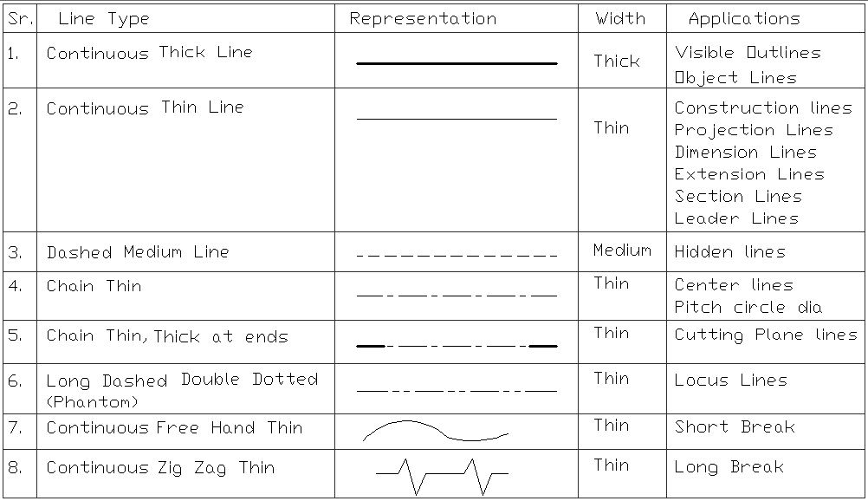
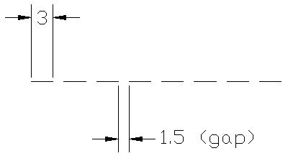
Line Types

Slide 5
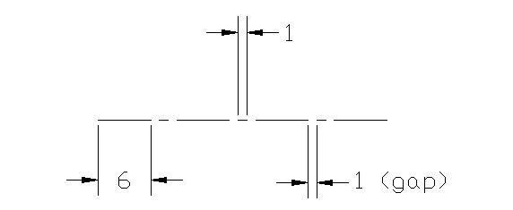
Line Types

Slide 6
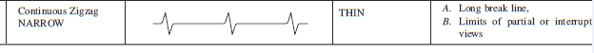
Line Types

Slide 7
Thanks

